Slide 1
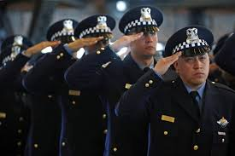
PROJECT CODE BLUE
Team Legal
Colby Maxwell
Matt Johnson
Mike Brickner
Tommy South

Slide 2
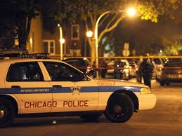
Does Temperature Affect Crime Rates ?

Slide 3
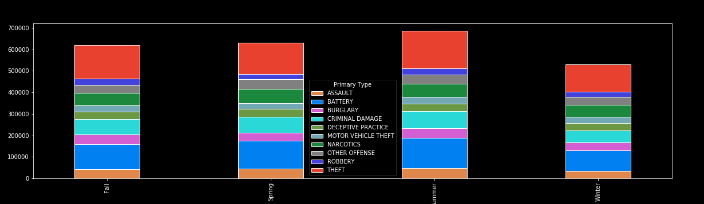
Total Top Ten Crime Rates By Season – Jan 2010 to Dec 2017

Slide 4
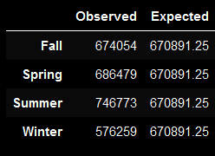
CHI Square
P value of the data 0.0 - This tells us that there is a statistical difference between the data observed and what the expected is if crime was even distributed
In the Fall, all crime goes up 0.04% from yearly average.
In spring crime goes up 2% from yearly average.
In summer crime goes up 11.3% from yearly average.
In winter crime goes down 14.1% from yearly average.

Slide 5
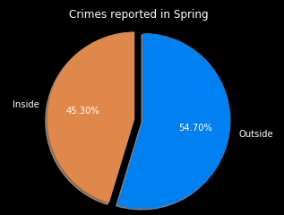
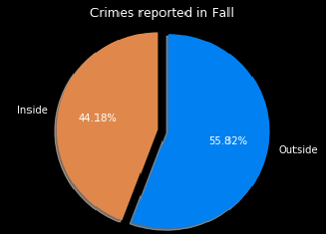
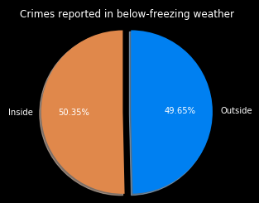
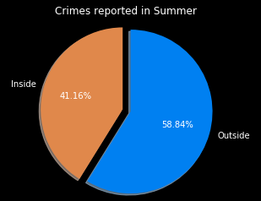
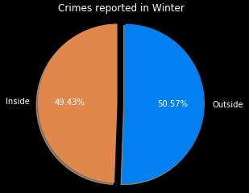
Inside VS Outside Crime Rates By Season

Slide 6
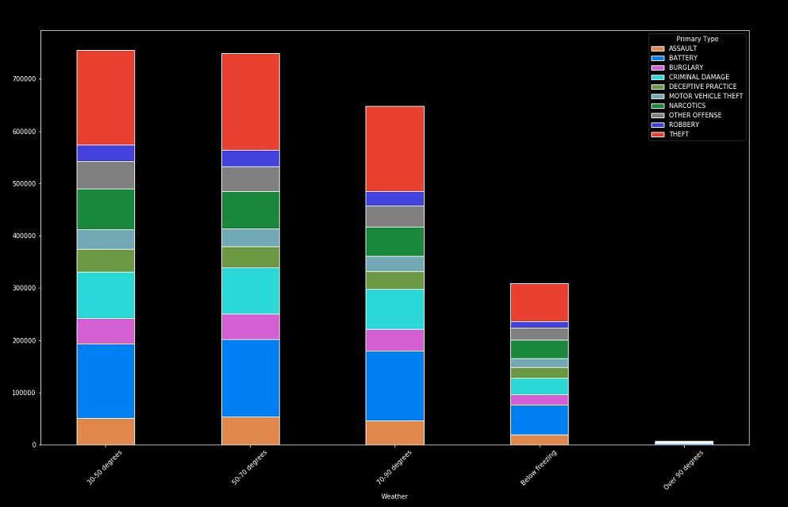
Total Top Ten Crime Rates By Temperature Range Jan 2010 to Dec 2017

Slide 7
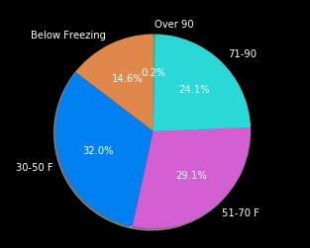
Total Days By Temperature Range - Jan 2010 to Dec 2017

Slide 8
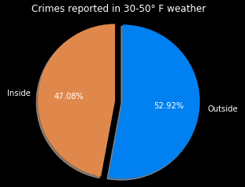
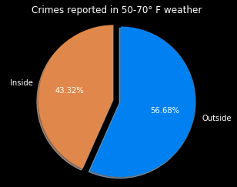
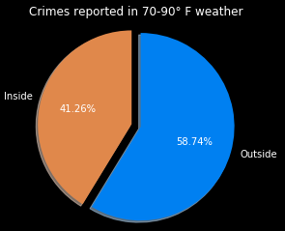
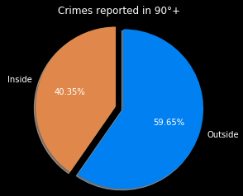
Inside VS Outside Crime Rates by Temp Range

Slide 9
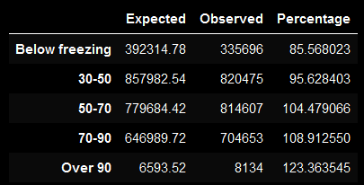
CHI Square
P value of the data is 0.0 This tells us that there is a statistical difference between the data observed and what the expected is if crime was even distributed
Expected = (total days within temperature range/overall total days) * (total crime)
Below freezing = 476 days
30-50 = 1041 days
50-70 = 946 days
70-90 = 785 days
Above 90 = 8 days
Total Days = 3266 days

Slide 10
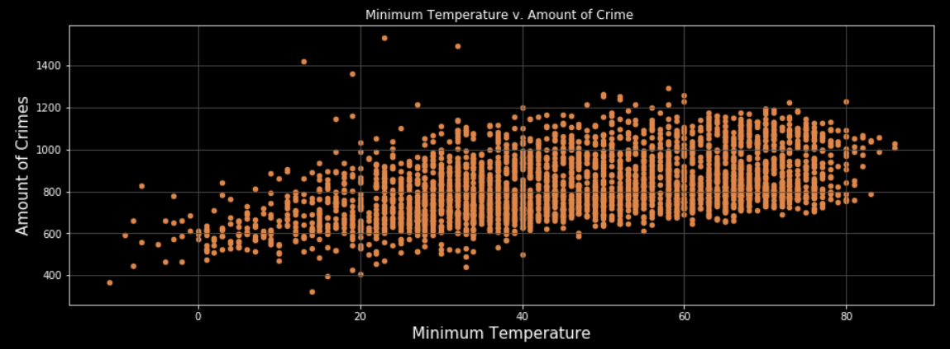
Total Crimes Per Day – Jan 2010 to Dec 2017

Slide 11
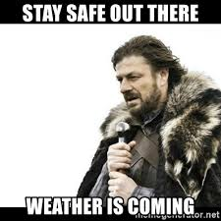
Thank You

